Slide 1
Our prototype :0
Done by Team 3

Slide 2
What is our problem?
Multiplayer video games, who doesn’t love to play these? But doesn’t it bother you, to realise that someone who crushes us easily in our ranked games, even though we are of “similar” ranks? Why is there such a wide skill difference between players? Isn’t the ranked match based on rank to avoid such situations? What can we do to make matchmaking for ranked matches fair?

Slide 3
What is our solution?
Our team decided to code an AI that monitors the gameplay of casual matches, and notes down the , and these will be converted into a new feature, called skill level.
Skill levels are based of kill ratio, (kill count over games played) and this shall be used for matchmaking for ranked match. This will allow for fair matches among similar-skilled players, thus a much more enjoyable and competitive experience as they try to improve on their skills. Ratings will be used as rankings, where you can be either a Rookie, Veteran, Master, Pro, Elite and Legendary)
This will not affect the casual games negatively, it just increases the competitiveness of those players who wish to be in a better skill level and it does not affect players who wish to play only in casual.

Slide 4
Our Test Game
Call of Duty: Mobile is a first-person shooter video game franchise published by Activision. We decided to use this game as it seemed familiar to all of us and we knew how the matchmaking for ranked matches worked. We realised that it could be improved and started working on it.

Slide 5
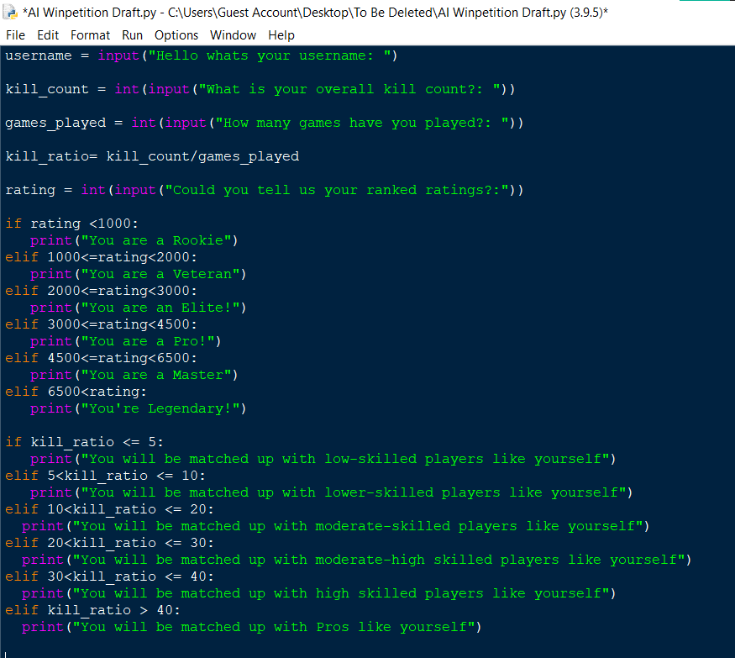
Our Solution
We started writing different codes separately for the inbuilt Ranking System in COD and our own ranking system: the Kills per Game ratio. It is a general idea of a player’s contribution to the game, so we plan to combine both of these to form the proper AI to solve this problem

